Slide 1

Internet Programming I
Chapter 4
JavaScript: Functions
Group: 5
3rd Year Sec B Students,
Dept. of Software Eng.
Jan 2022, AASTU

Slide 2

Objectives
After success completion of the session you will be able:
To Declare of function and understand its scope
To understand about JavaScript nested function
To understand the basics about parameters and arguments
To describe different kinds of parameters
To understand getter and setter methods.
To know about the argument object property.
To understand function Hoisting.
To describe different kinds of functions
To know mostly used methods in objects, date, and

Slide 3
Outline
Main Topic
Overview of Function
Components of Function
Types of Function
Function nesting and closure
Hoisting
Special function: setter and getter
mostly used Built in method by category

Slide 4
4.1 overview of Function
A function is a block of code that performs a specific task.
A function declaration tells the JavaScript engine about a function’s name, return type, and parameters.
Syntax:
function name( parameter1, parameter2, parameter1){
statements;
}
A function is declared using the function keyword.
The basic rules of naming a function are similar to naming a variable. It is better to write a descriptive name for your function. For example, if a function is used to add two numbers, you could name the function add or addNumbers.
The body of function is written within {}.
← This are the components of functions

Slide 5
4.2 Parameters and Arguments
Default parameter – allows formal parameter to be initialized to default value if no value or undefined is passed:
Example:
function add(a, b = 1) {
return a + b;
}
console.log(add(5, 2));
// expected output: 7
console.log(add(5));
// expected output: 6

Slide 6
2.What is the argument object
Argument objects – array-like local objects used to store arguments of non-arrow functions:
Example:
function findMax() {
let max = -Infinity;
for(let i = 0; i < arguments.length; i++) {
if (arguments[i] > max) {
max = arguments[i];
}
}
return max;
console.log(findMax(2, 3, 4, 5, 6)) // 6 is output
}

Slide 7
Rest parameters
Rest parameters allows a function to accept indefinite number of arguments as an array. Syntax: function add(num1, num2, ...theArgs) {}
Example:
function add(num1, num2, ...otherNums) {
let normal_paramAdd = num1 + num2;
let other_paramsAdd = 0
let all_paramsAdd = 0
for(let i = 0; i < otherNums.length; i++) {
other_paramsAdd += otherNums[i];
}
}
add(1, 2, 3, 4, 5)
//output 3, 12, 15
for (let j = 0; j < arguments.length; j++) {
all_paramsAdd += arguments[j];
}
console.log(normal_paramAdd)
console.log(other_paramsAdd)
console.log(all_paramsAdd)text
}

Slide 8
4.2.2. JavaScript Function Calling
The Function call is a predefined JavaScript method, which is used to write methods for different objects. It calls the method, taking the owner object as an argument.
JavaScript functions can be called:
- As a function
- As a method
- As a constructor
- via call and apply
Syntax:
call()
Return value: It calls and returns a method with the owner object being the argument.

Slide 9
4.2.2. continued…
Calling a function as a function
Calling a function as a method
<button onclick="sayHello()">say hello</button>
<script>
function sayHello() {
console.log(this);
console.log(arguments);
console.log('hello');
}
</script>
<button onclick="greeter.sayHello()">say hello</button>
<script>
greeter = {
sayHello: function () {
console.log(this);
console.log(arguments);
console.log('hello');
}
}

Slide 10
4.2.2. continued…
Calling a function as a constructor
Calling a function via call and apply
function Greeter(name) {
console.info('begin constructor');
console.log(this);
console.log(arguments);
this.name = name;
console.info('end constructor')
}
function sayHello() {
var name = document.getElementById('name').value;
var grtr = new Greeter(name);
console.log('hello ' + grtr.name);
const person = {
fullName: function() {
return this.firstName + " " + this.lastName;
}
}
const person1 = {
firstName:"John",
lastName: "Doe"
}
const person2 = {
firstName:"Mary",
lastName: "Doe"
}
// This will return "John Doe":
person.fullName.call(person1);

Slide 11
4.3 Types of function
Here are the major classification of functions
classical Functions
Function Expression
Anonymous function
Arrow Function
Classical Functions
This are the functions that are used normally in javascript with the following syntax
function nameOfFunction () {
// function body
}

Slide 12
4.3.2 JavaScript Function Expression
A function expression is very similar to and has almost the same syntax as a function declaration.
The main difference between a function expression and a function declaration is that it can be stored in a variable.
Such a function can be anonymous; it does not have to have a name. const square = function(number) { return number * number }
var x = square(4)
Also by Providing a name allows the function to refer to itself, and also makes it easier to identify the function in a debugger's stack traces: const factorial = function fac(n) { return n < 2 ? 1 : n * fac(n - 1) }
console.log(factorial(3))

Slide 13
4.3.3 Anonymous Function
In JavaScript, an anonymous function is that type of function that has no name or we can say which is without any name.
We can also use an anonymous function as an argument for another function.
setTimeout(function () {
console.log('Execute later after 1 second')
}, 1000);
In order to invoke and execute a function immediately after its declaration, creating an anonymous function is the best way. (function() { console.log('Hello'); })();

Slide 14
4.3.4 Arrow Function
An arrow function expression is a compact alternative to a traditional function expression, but is limited and can't be used in all situation.
Differences & Limitations:
Does not have its own bindings to this or super, and should not be used as methods.
Does not have new.target keyword.
Not suitable for call, apply and bind methods, which generally rely on establishing a scope.
Can not be used as constructors.
Can not use yield, within its body.

Slide 15
4.3.4 continued…
Arrow Function General Syntax:
let myFunction = (arg1, arg2, ...argN) => { statement(s)}
Additional syntax types include:
param => expression
(param1, paramN) => expression
param => {
let a = 1;
return a + param;
}

Slide 16
4.3.4 continued…
Comparing traditional functions to arrow functions
// Traditional Anonymous Function
function (a){
return a + 100;
}
// Arrow Function Break Down
// 1. Remove the word "function" and place arrow between the argument and opening body bracket
(a) => {
return a + 100;
}
// 2. Remove the body braces and word "return" -- the return is implied.
(a) => a + 100;
// 3. Remove the argument parentheses
a => a + 100;
// Traditional Function
function bob (a){
return a + 100;
}
// Arrow Function
let bob = a => a + 100;
// Traditional Anonymous Function
function (a, b){
let chuck = 42;
return a + b + chuck;
}
// Arrow Function
(a, b) => {
let chuck = 42;
return a + b + chuck;
}

Slide 17
4.4 Closure
A closure is an expression (most commonly, a function) that can have free variables together with an environment that binds those variables (that "closes" the expression).
A closure is a function that remembers its outer variables and can access them.
The closure has three scope chains listed as follows:
Access to its own scope.
Access to the variables of the outer function
Access to the global variables.
In JavaScript, closures are created every time a function is created, at function creation time.

Slide 18
4.4.3 Nested Function
A nested function is a function inside another function.
one of the biggest feature in javascript is the ability to create function inside a function.
Since a nested function is a closure, this means that a nested function can "inherit" the arguments and variables of its containing function.
In other words, the inner function contains the scope of the outer function.
Example:
function addSquares(a, b) {
function square(x) {
return x * x;
}
return square(a) + square(b);
}
a = addSquares(2, 3); // returns 13
b = addSquares(3, 4); // returns 25
c = addSquares(4, 5); // returns 41
function outside(x) {
function inside(y) {
return x + y;
}
return inside;
}
fn_inside = outside(3); // Think of it like: give me a function that adds 3 to whatever you give
// it
result = fn_inside(5); // returns 8
result1 = outside(3)(5); // returns 8

Slide 19
4.4.3 Function Scope
Variables defined inside a function cannot be accessed from anywhere outside the function
A function defined inside another function can also access all variables defined in its parent function, and any other variables to which the parent function has access
JavaScript has 3 types of scope:
Block scope
Function scope
Global scope
function myFunction() { let carName ="Volvo"; //Function Scope
}
A function body creates a scope for let, const and even function declarations.

Slide 20
4.5 Special kinds of methods(Accessor Property)
In JavaScript, accessor properties are methods that get or set the value of an object. For that, we use these two keywords:
get - to define a getter method to get the property value - getter methods are used to access the properties of an object
set - to define a setter method to set the property value
- setter methods are used to change the values of an object.
const student = { firstName: 'Monica',
// accessor property(getter)
get getName() {return this.firstName; }
};
console.log(student.firstName); // Monica
// accessing getter methods
console.log(student.getName); // Monica
// trying to access as a method
console.log(student.getName()); // error
const student = { firstName: 'Monica',
//accessor property(setter)
set changeName(newName) {
this.firstName = newName;
}
};
console.log(student.firstName); // Monica
// change(set) object property using a setter
student.changeName = 'Sarah';
console.log(student.firstName); // Sarah

Slide 21
4.6 Hoisting
Hoisting in JavaScript is a behavior in which a function or a variable can be used before declaration.
Variable Hoisting
a = 5;
console.log(a);
var a; // 5
Funciton Hoisting
greet();
function greet() {
console.log('Hi, there.');
}

Slide 22
4.7 mostly used built in Functions by catagory
Object methods
Object.create() | is used to create a new object and link it to the prototype of an existing object.
Object.keys() | creates an array containing the keys of an object.
Object.values() | creates an array containing the values of an object.
Object.entries() | creates a nested array of the key/value pairs of an object.
Object.assign() | is used to copy values from one object to another.
Object.freeze() | prevents modification to properties and values of an object, and prevents properties from being added or removed from an object.

Slide 23
continued…
Math methods
log() | Returns the natural logarithm (base E) of a number.
max() and min() | Returns the largest and smallest of zero or more numbers repectively.
random() | Returns a pseudo-random number between 0 and 1.
round() | Returns the value of a number rounded to the nearest integer.
exp() | Returns E^{N}, where N is the argument, and E is Euler's constant, the base of the natural logarithm.
ceil() | Returns the smallest integer greater than or equal to a number.

Slide 24
continued…
Date methods
Date() | returns a string representation of the current date and time
getDate() and getDay() | Returns the day of the month/weekfor the specified date according to local time respectively.
setDate() | Sets the day of the month for a specified date according to local time.
getUTCDate() | Returns the day (date) of the month in the specified date according to universal time.
getTimezoneOffset() | Returns the time-zone offset in minutes for the current locale.
toSource() | Returns a string representing the source for an equivalent Date object; you can use this value to create a new object.

Slide 25
Practical Exercises
What is the difference between JavaScript function declaration and function expression.
What is The difference between getter and setter methods in javascript?
What is The argument object?
What is Hoisting?
Write a JavaScript function that accepts two arguments, a string and a letter and the function will count the number of occurrences of the specified letter within the string?
Write a JavaScript program to pass a 'JavaScript function' as parameter?
Write a JavaScript function that checks whether a passed string is palindrome or not?

Slide 26
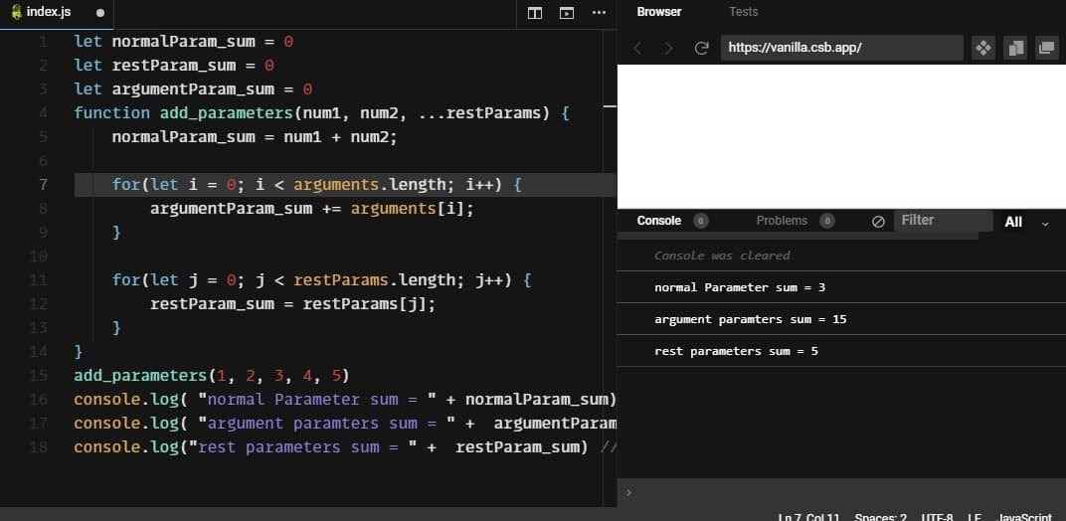
Demonstration question
Write a function that has two parameters and additional rest parameters. Your task is to write a function that finds summation of passed arguments for normal parameter, argument objects and rest parameters. [rest parameters, and argument object exercise]

Slide 27
Demonstration question
2. update activity 6 html code and write a built in function in your js code that will display the time of arrival for the plane by using the built in function DATE();. additional create additional object by using object.create() method and display the properties and values by using the built in methods object.keys() and object,values() in the text area.
let keys = () => {
let keyValues = Object.keys(Airplane);
document.getElementById('text').innerHTML = "object keys are: " + keyValues;
}
let values = () => {
let obValues = Object.values(plane);
document.getElementById('text').innerHTML = "object values are: " + obValues;
}
const Airplane = {
name: "none",
model: "boing",
date: Date(),
print: function(){
document.getElementById('text').innerHTML = "plane name: " + this.name;
}
};
const plane = Object.create(Airplane);
plane.name = "emirates";
plane.model = "boing";
plane.date = Date();

Slide 28
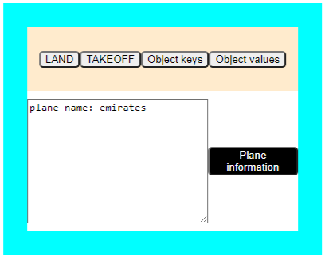
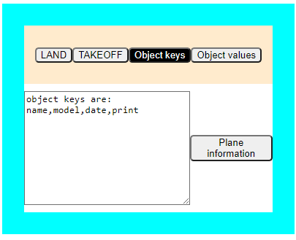
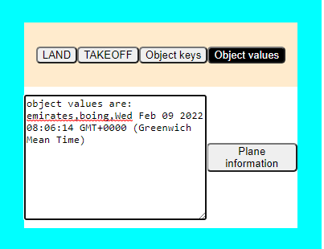
Demonstration question
OUTPUT:
object.create() =>
object.key() ⇑
using Object.value() and Date() ⇒

Slide 29
Reading Resources/Materials
Links
https://developer.mozilla.org/en-US/docs/Web/JavaScript/Reference/Statements/function
https://www.w3schools.com/js/js_scope.asp
https://developer.mozilla.org/en-US/docs/Web/JavaScript/Reference/Functions/get

Slide 30

Thank You
For Your Attention!!

